Slide 1
Facemask Detection
Preetham Shankare Gowda
Sai Harish Paleti
Pooja Singh

Slide 2
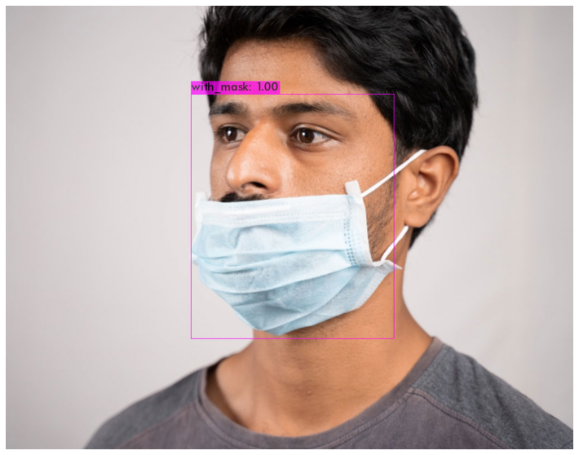
Objective:
To detect if a person or people in a given image/video frame is wearing a mask or not.

Slide 3
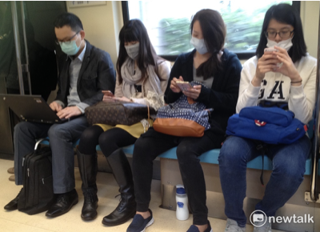
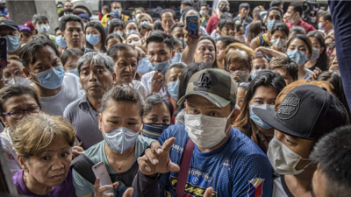
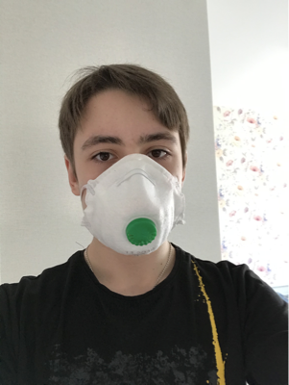
Dataset:
https://www.kaggle.com/andrewmvd/face-mask-detection

Slide 4
Methodologies:
3-step approach
U-Net
YOLOv3

Slide 5
3 Step Approach:
The initial approach we had in mind
Steps
Localization
Feature Extraction
Classification

Slide 6
U-Net:
Semantic segmentation.
Commonly referred to as dense prediction.
The output itself is a high resolution image.

Slide 7
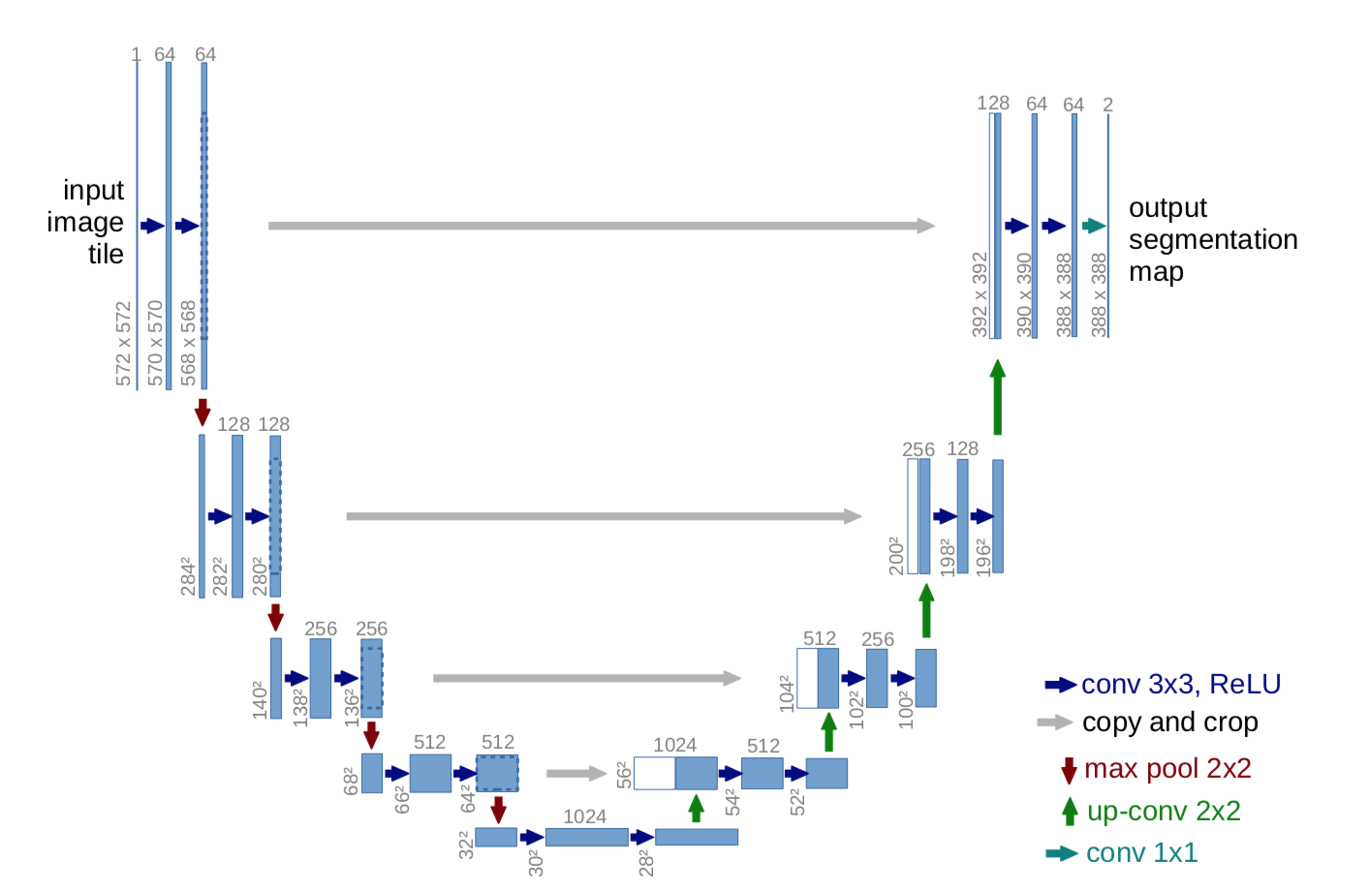
U-Net Architecture:

Slide 8
U-Net steps:
Convolution operation
Max pooling operation
Need for up sampling
Transposed Convolution

Slide 9
YOLOv3
Makes detections at three different scales.
Prediction at three scales.
The shape of the detection kernel is 1 x 1 x (B x (5 + C) ).
Output is generated by applying a 1 x 1 kernel on a feature map.

Slide 10
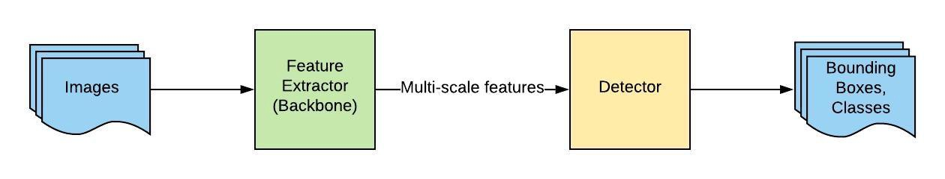
YOLOv3 Architecture:

Slide 11
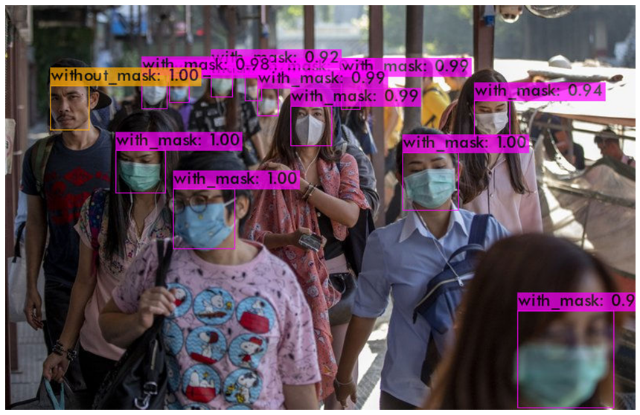
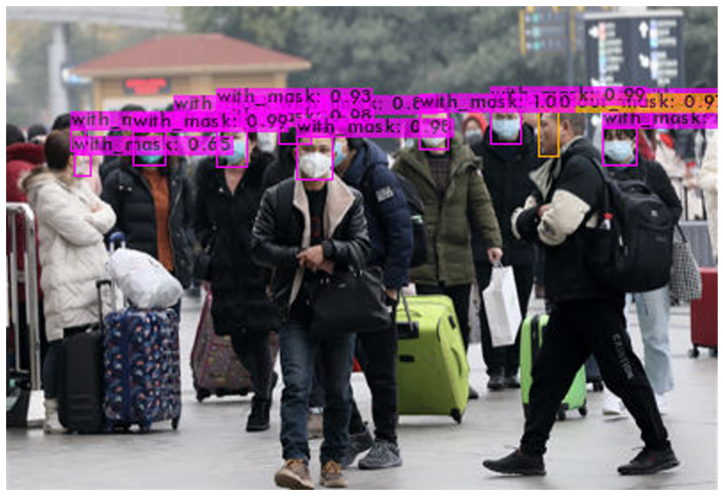
Results:
The YOLOv3 approach has given us an accuracy of 94%.
With better training set we can achieve much better accuracy.

Slide 12
Future work:
YOLO v5
U-Net
Better results

Slide 13
Thank You.

